Slide 1
Hack the Future:
A Gen AI Sprint Powered by Data

Slide 2



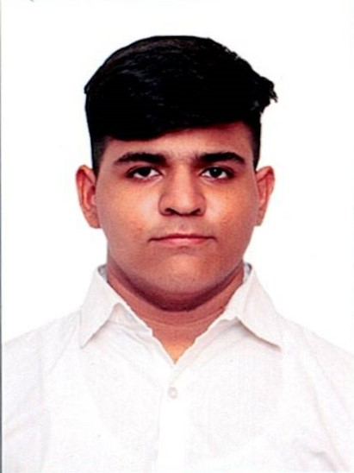
Hack the Future: A Gen AI Sprint Powered by Data
Data and AI Week
Team details
TEAM NAME: iQube
Yuvraj Gupta (Team Leader)

Slide 3
Entry Submission Summary
Idea Title (Provide a concise and impactful title for your idea.) | JobGenie
Team Name | iQube
Problem Statement | Enhancing Job Screening with AI and Data Intelligence
Proposed Solution | We present JobGenie, a CLI-based multi-agent AI system that automates the job screening process. It: Summarizes job descriptions. Parses and evaluates resumes. Matches candidates using relevance scoring. Shortlists the best-fit candidates. Automatically sends out personalized interview invites. All operations are handled using local on-prem LLMs (Ollama), and long-term memory is managed via SQLite.

Slide 4
Problem Statement 5: Enhancing Job Screening with AI and Data Intelligence
Challenge Overview:
The recruitment process often involves manually reviewing numerous job descriptions (JDs) and CVs, which can be time-consuming and prone to human error. The goal of this hackathon is to develop a multi-agentic AI system that can automatically read and summarize job descriptions (JDs), match candidate qualifications with the JD, shortlist candidates, and send interview requests based on the match

Slide 5
Proposed Solution Overview
We present JobGenie, a CLI-based multi-agent AI system that automates the job screening process. It:
Summarizes job descriptions.
Parses and evaluates resumes.
Matches candidates using relevance scoring.
Shortlists the best-fit candidates.
Automatically gives personalized interview invites.
All operations are handled using local on-prem LLMs (Ollama), and long-term memory is managed via SQLite.

Slide 6
Technologies Used
Ollama (On-Prem LLMs)
Python
SQLite
Ollama Embedding Models
BeautifulSoup / Selenium (Web Scraping)
Custom API Tools

Slide 7
Agents' interaction design
JD Agent – Parses job description using LLM → Extracts role, skills, experience.
Resume Agent – Reads and extracts resume details using NLP.
Matching Agent – Uses embedding similarity to compute match score.
Interview Inviter Agent – Gives the personalized email for particularly shortlisted candidates .
Agents communicate via a central Python orchestrator and persist data in SQLite.

Slide 8
Code structure
JobGenie/
│
├── agents/
│ ├── jd_summarizer.py
│ ├── cv_parser.py
│ ├── matcher.py
│ └── interview_inviter.py
├── data/
│ ├── job_description.csv
│ └── resumes/
│ └── C1061.pdf
├── tools/
│ ├── db_handler.py
│ └── ollama_handler.py
│
├── shortlisted.db
├── main.py
├── requirements.txt
└── README.md

Slide 9
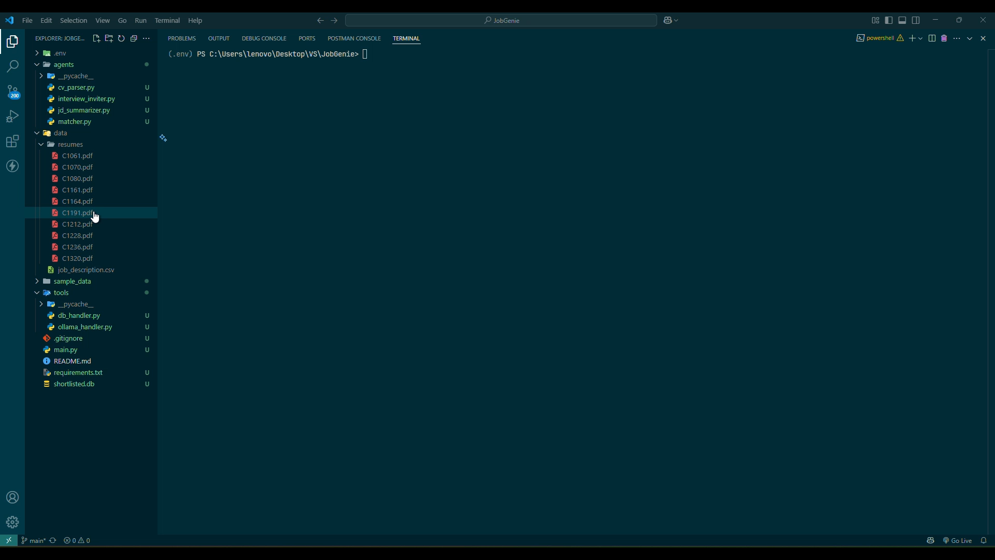
Demo video

Slide 10
Conclusion
Impact & Effectiveness: JobGenie dramatically improves recruitment efficiency by reducing manual screening time, minimizing human error, and accelerating candidate outreach. It ensures a structured, data-driven approach to hiring using responsible, on-prem AI.
Problem Solved: Automates the end-to-end job screening lifecycle with explainable and traceable outputs.

Slide 11
References/Other details
Ollama Documentation
SQLite Official Docs
Python langchain agents (optional)
BeautifulSoup & Selenium
Custom prompt engineering with local models

Slide 12

Thank You

